Slide 1
Applied Finance Project
Pricing Convertible Bonds
Group 17
Christian Henderson, Luis Hernán Gómez, Chu-Hsien Wang, Tingyu Yan

Slide 2
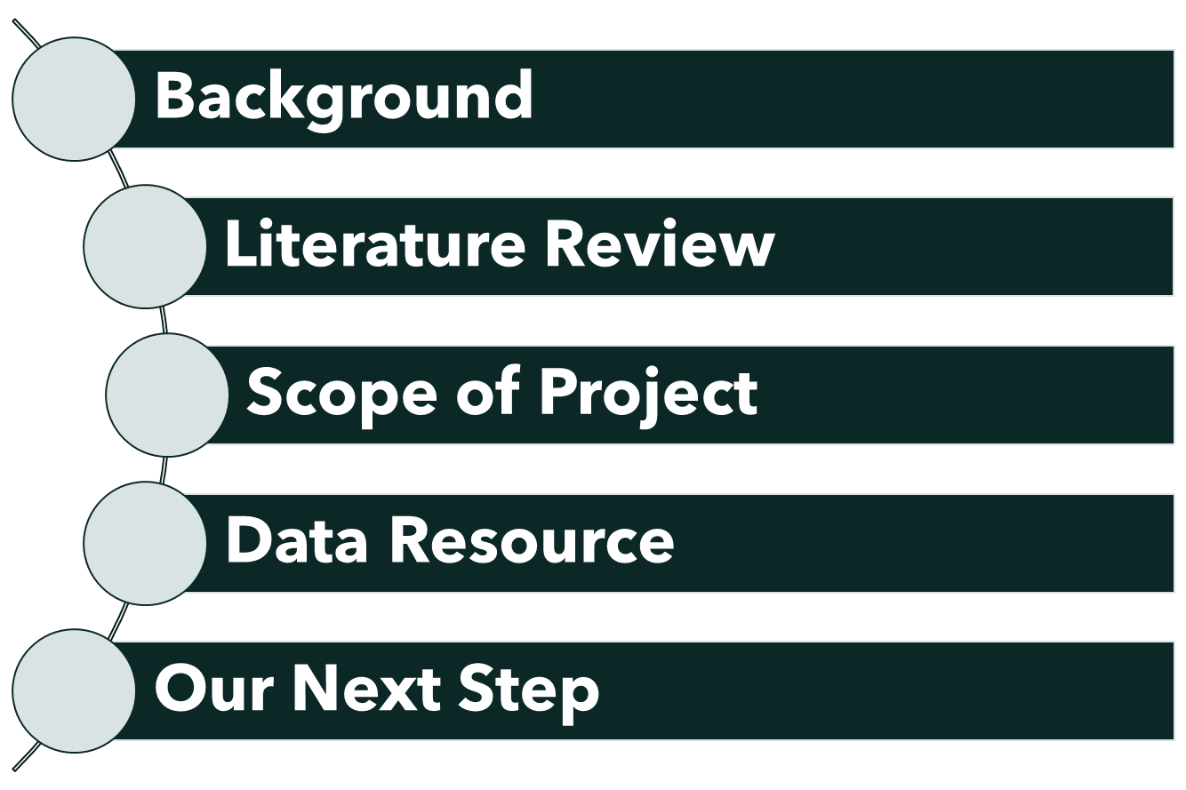
Table of Contents

Slide 3
01. Background

Slide 4
Background
Understanding the pricing of default risk or credit risk is of critical importance since almost every financial security is impacted by credit risk to a certain extent (except for traditional fixed income instruments). Over the past decade, the financial industry has come under pressure to understand and quantify these risks.
As a result, the academic literature on modeling credit risk has been growing fast. With developing a model for pricing, the credit rating for bonds will also have to be developed in a second model.

Slide 5
Background (cont’d)
Short-rate modeling is a topic extensively researched in fixed income with numerous papers and models available online. When pricing credit instruments in the financial markets, practitioners commonly need to model corporate yields or corporate credit spreads (spread over the risk-free rate).
Unfortunately, there are significantly less models available where the credit spreads are modeled in connection with risk-free rates. There are two types of approaches in such models; structural and reduced-form (which is an approach that uses stochastic processes). In this research project, we are looking to implement stochastic models that incorporate both short-rates and credit spread modeling.

Slide 6
02. Literature Review

Slide 7
Modeling the dynamics of Credit Spreads with Stochastic Volatility
1:Two-factor affine model for the credit spreads on corporate bonds:(1) level of the spread (2) volatility of the spread
2:This approach allows us to model the volatility of corporate credit spreads as stochastic, and also allows us to capture higher moments of credit spreads
3: The model is found to be successful at fitting actual corporate bond credit spreads, resulting in a significantly lower root mean square error than a standard alternative model both in sample and out of sample
4:key properties of actual credit spreads such as the stochastic volatility of the credit spreads and the positive skewness of the credit spread distribution are better captured by the model.

Slide 8
Credit Spreads and Interest Rate: A Cointegration Approach
Corporate rates are cointegrated with government rates.
In the short run an increase in treasury rates causes credit spreads to narrow.
In the long run an increase in treasury rates causes credit spreads to widen.
This is inconsistent with many models used in practice to price corporate bonds.
Effects on credit spread by increasing treasury rates in 1%.
Models | Short Term | Long Term
Cointegration Model | - | 1.028% increase in Aaa rates 1.178% increase in Baa rates
Impulse Response Functions | Aaa rates fall 34 basis points Baa falls 47 basis points | Aaa returns to its initial level Baa rises by 17 basis points

Slide 9
03. Scope of Project

Slide 10
Scope of Project
Phase 1 :Identify reduced form models in the literature that include modeling both risk-free rates and credit spreads in bonds.
Phase 2 :Implement the models generally used by the company, which involve the implementation of the Black Derman Toy (BDT) model on risk-free rate assuming constant credit spread, and the implementation of the BDT model on corporate yields (risk free rate + credit spread) in historical data using the ICE database and test their performance.
Phase 3 :Test the performance of other approaches found in the literature where both the credit spread and the risk free are modeled in the same process. Initially, test the performance of Duffee’s model in the historic data assuming constant volatility. Likewise test the Cointegration Approach by Morris and Neal, and the two-factor credit model (with credit spread and credit volatility as factors) proposed in the Jacobs and Li paper. Try to tune the models with specific parameters such as maturity and credit rating, looking to improve the degree of precision.
Phase 4 :Determine the optimal model. Incorporate additional elements from literature to tune the model and improve its performance. Prepare comparison tables between the different models.

Slide 11

Black-Derman Toy (BDT Tree)
Constructing the model
Assume that at time h, the short-term rate r(h) can take on the two values: ru and ra.

Slide 12
Verifying the model
Input the market data into the BDT tree - using the expressions at the nodes of the generic BDT tree and plugging in the data - which depicts the 1-year effective annual rates. The tree will be different from the binomial trees we have seen so far, e.g.,
Notes:
Unlike a stock-price tree, the nodes are not necessarily "centered" on the previous period nodes; this is because the tree is matching the data by construction. One can verify that the recipe for the values at the nodes given in the generic BDT tree is indeed consistent with the data:

Slide 13
04. Data Resource Preliminary Results

Slide 14
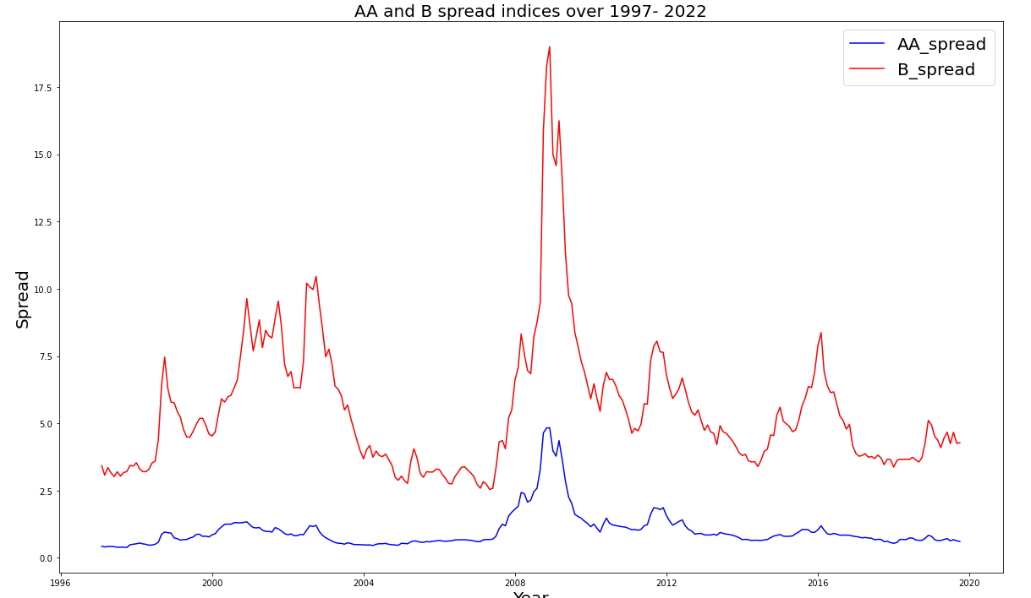
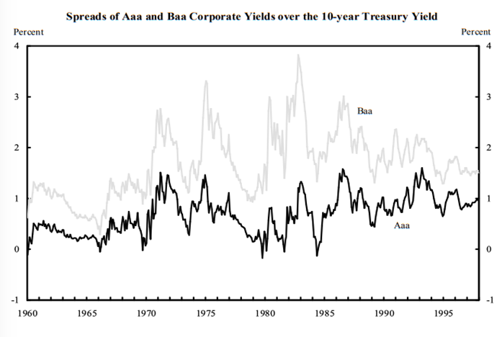
Aaa and Baa Spreads: periods 1960-1997 and 1996-2022

Slide 15
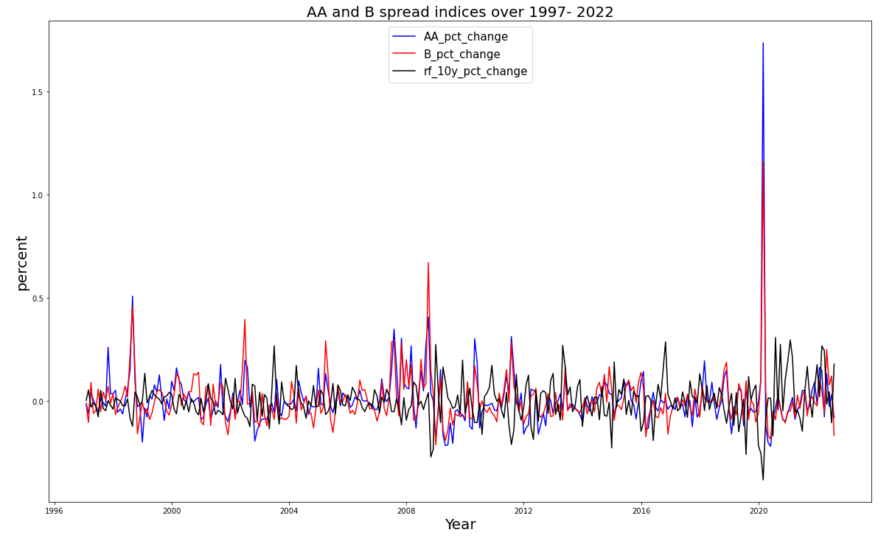
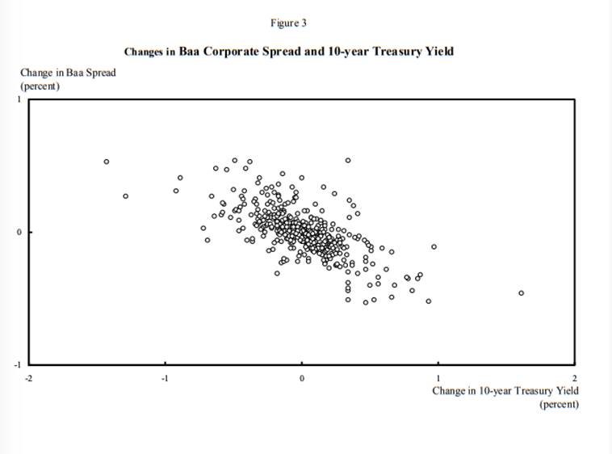
Relationship Between Changes in Interest Rates and Changes in Credit Spreads

Slide 16
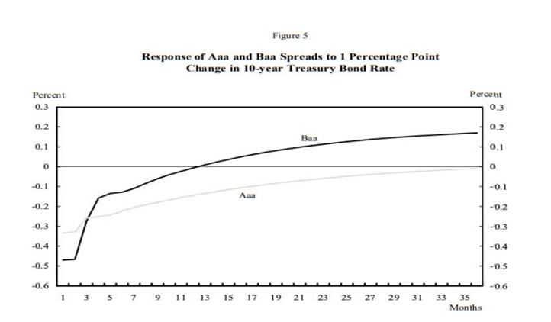
Verifying the Correlation Coefficients
We used Treasury Fed rates and AA and B indices from 1997-2022.
In the short term we obtained very similar correlation coefficients: -0.35 for AA and -0.42 for B
In the long term we had different findings: 0.021 for AA and 0.022 for B

Slide 17
Data Resource
Main Resource: ICE database and dataset provided by KPMG
Pricing data for callable bonds
Market data on risk-free rates
Market data on corporate yield curves.

Slide 18
05. Implementation and Results

Slide 19
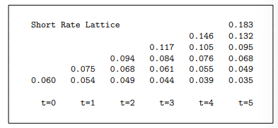
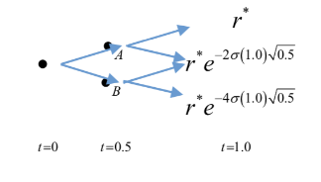
Short Rate Lattice
We take the spot rates from the Fed treasuries and complete the curve with linear interpolations. With the values from this curve, we compute the D(T) values.
We select the short rate values at the nodes of our lattice such that the prices of a ZCB at different maturities match the D(T) values calculated.

Slide 20
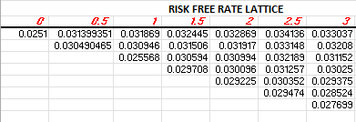
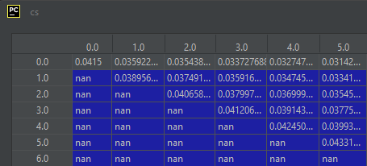

Credit Spread Lattice

Slide 21
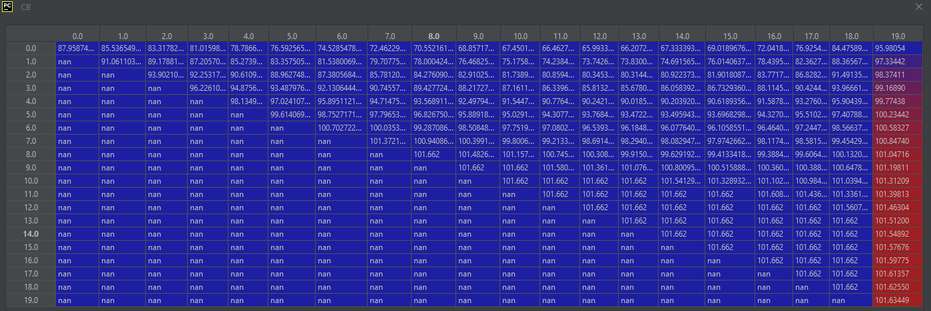

Callable Bond Lattice

Slide 22
Results

Slide 23
Conclusions
The Investment Grade bonds in our dataset are called more frequently than the High Yield bonds. Given the high spread of the High Yield Bonds, it is common to see that the continuation value is almost always smaller than the exercise value, which means that for this group generally, the bonds are not likely to be called.
The models that incorporate the Cointegration Approach have a similar performance to the standard models that assume a constant credit spread. However, they do not improve the performance. This could be explained partly by the fact that this relationship is not contemplated by the individuals who trade these securities.
The models tested in this project, have a better performance on the Investment Grade category. This can partly be explained by the liquidity factors that surround the High Yield Bonds as these can have effects on prices that are not contemplated in our model.
Our models have better performances when there is a high volatility assumption. This means that the traded prices contemplate high volatility scenarios.

Slide 24
Thank you. Company: KPMG Faculty Advisor: Francis Longstaff Professor: Ehud Peleg

